Slide 1
Introduction to Information Systems and Programming
Abstract Class and Interface (Part 2)
[some materials adopted from Liang, Introduction to Java Programming]

Slide 2
Interface
Interface is a class-like programming construct that contains only constants and abstract methods
In many ways similar to abstract class, as we will see
But its intent is to specify common behavior / characteristics of objects of related classes or unrelated classes, e.g., comparable, eatable, etc

Slide 3
Interface Example
public interface Eatable {
public abstract String howToEat();
}
class Animal{
}
class Chicken extends Animal implements Eatable {
public String howToEat(){
return "chicken: fry it";
}
}
class Dog extends Animal {
}
class Chocolate implements Eatable {
public String howToEat() {
return "chocolate: eat everyday";
}
}

Slide 4
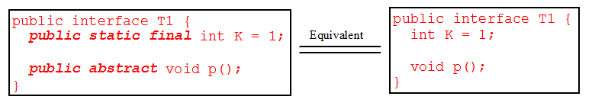
Interface
In interface, since all data fields are public static final and all methods are public abstract, these modifiers are ok to be omitted
Similar to abstract class:
Cannot create an instance from an interface using the new operator
Ok to use an interface as a data type for a variable
Use it for casting
etc

Slide 5
Comparable Interface
Suppose you want to design a generic method to sort the objects of the same type: circles, rectangles, students, fruits
We need common behavior for the objects: comparable
Java provide the Comparable interface for this purpose
Classes that implement the Comparable interface become comparable

Slide 6
Comparable Interface
Comparable interface provided by Java:
public interface Comparable<E> {
public abstract int compareTo(E o);
}

Slide 7
Comparable interface example
class Circle extends GeometricObject implements Comparable<Circle>{
private double radius = 1;
Circle() {
}
Circle (double radius) {
this.radius = radius;
}
public int compareTo(Circle c){
if (this.radius > c.radius)
return 1;
else if (this.radius == c.radius)
return 0;
else
return -1;
}
}

Slide 8
Comparable Interface
Implements Comparable<E>: provides implementation for the abstract method public int compareTo(E o)
Comparable interface is a generic interface, the generic type E is replaced by a concrete type when implementing the interface
Classes Integer, String, Date, etc all implement Comparable, thus they are comparable

Slide 9
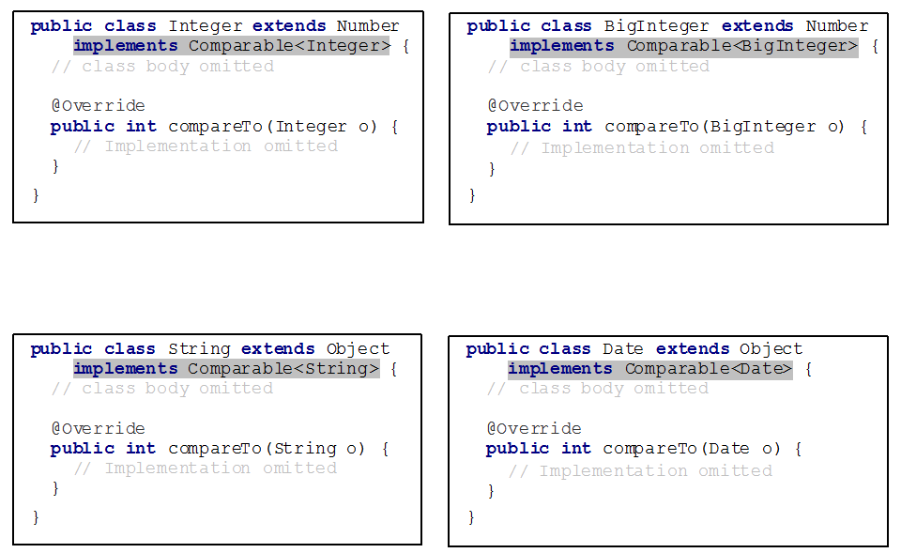
Comparable Interface

Slide 10
Comparator Interface
Comparator interface can be used to:
Provide addition way of ordering
Comparable<E>.compareTo() defines the “natural” ordering for E
Comparator<E>.compare() defines additional, alternative ordering for E
Enable comparison for objects which their classes do not implement comparable

Slide 11
Comparator Interface Example
Allow Integer to be ordered based on their absolute value
public class IntegerAbsComparator implements Comparator<Integer> {
public int compare(Integer a, Integer b) {
if (Math.abs(a) > Math.abs(b))
return 1;
else if (Math.abs(a) == Math.abs(b))
return 0;
else
return -1;
}
}
// code skip
Collections.sort(l, new IntegerAbsComparator());

Slide 12
Cohort Activity
Comparable for Octagon
Comparator for Octagon

Slide 13
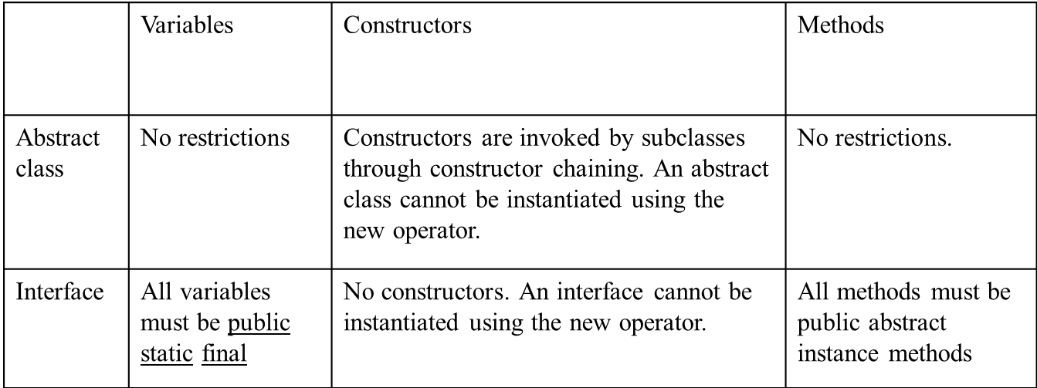
Abstract Class vs. Interface
Interface: all data must be constants
Abstract class: all types of data
Interface: all methods are abstract (signature only)
An abstract class can have concrete methods

Slide 14
Abstract Class vs. Interface
All classes share the same root, Object; but there is no single root for interfaces
Like a class, a variable of an interface type can reference any instance of the class that implements the interface
If a class implements an interface, this interface plays the similar role as a superclass

Slide 15
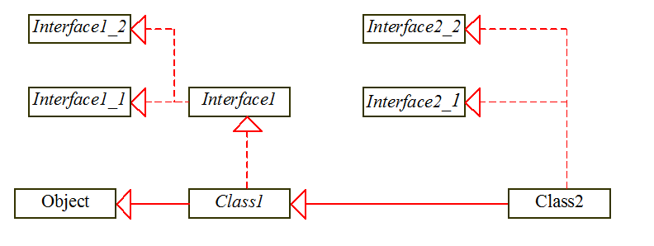
Abstract Class vs. Interface
If c is an instance of Class2, c is also an instance of Object, Class1, Interface1, Interface1_1, Interface1_2, Interface2_1, Interface2_2

Slide 16
Cohort Activity
Implement the software framework in the previous slide

Slide 17
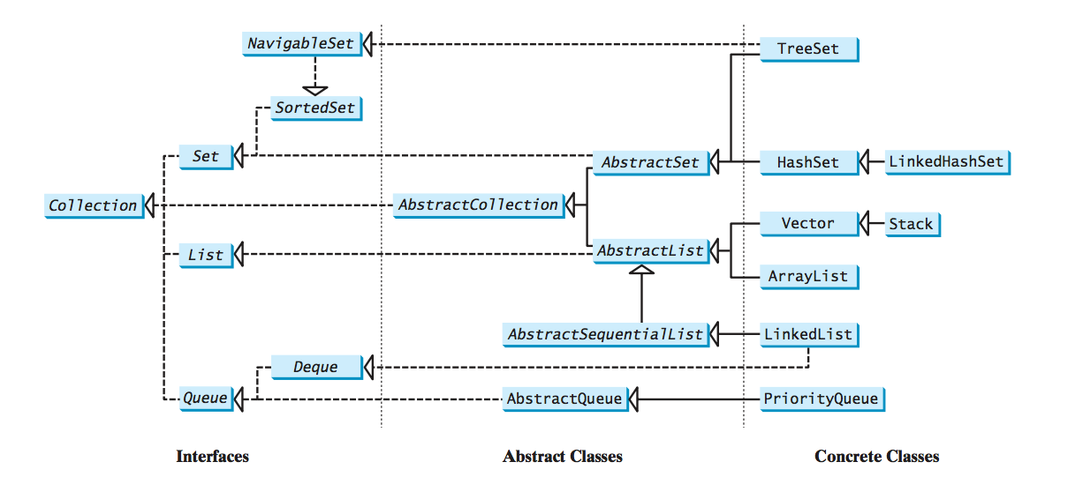
Java Collection Framework

